Slide 1

Zowe Q1 2023 PI Planning
ZAC Update
Bruce Armstrong – Michael DuBois – Peter Fandel - Rose Sakach

Slide 2

Topics
Zowe By the Numbers
The Q4 Report Card
Zowe Market/Social News
How are we doing with Zowe V2 Conformance
Quick Zowe (Logistical) Roadmap Status
ZAC Priorities
Notes:
Rose Updated this, what do you think?

Slide 3
Zowe by the numbers
Another Quarter Of Growth!
Through Jan 24, 2023
23,153
8068
408
Quarterly CLI Downloads
Quarterly Explorer Downloads
Quarterly Server-Side Downloads
+ 2.5% over Q ending October
- 1.9% over Q ending October
- 0.4% over Q ending October
Quarterly Visitors at zowe.org
25
43 (V2)
2684 Total
- 5.5% over Q ending October
2398 New
- 8.2% over Q ending October
GitHub Contributors
Conformant Zowe Products
- 1.1% over Q ending October
+1 since Oct 21
https://www.metrics.zowe.org
https://www.metrics.zowe.org/analytics
Notes:
Changing metric to be Q-over-Q delta for downloads and visits
Analytics page is still busted – please fix
Now: 79351

Slide 4
The Arcati Mainframe - Yearbook 2023 The independent annual guide for users of IBM mainframe systems
2020: 10% using Zowe
2021: 19% using Zowe
2022: 38% using Zowe
2023: 69% will be using Zowe (based on existing + statements of intent)
https://itech-ed.com/arcati/newyearbook.pdf

Slide 5

Looking Back Three Months
Although the ZAC can’t take credit for progress
Strategic Planning
Lead efforts to complete Zowe Roadmap and collaborate with TSC
Identify & close gaps then bring visibility to Zowe security narrative
Explore demand for z/OS Event Management 🡺 TSC handoff
Research demand for Zowe internationalization
Extender Diversity
Leverage Zowe Chat to increase Extenders
Tech, Tooling, & Hardware
Continue pushing zBox configuration in support of Training & Certification
Blocked by OMP budget constraint
Notes:
Roadmaps: Yay …but wait.
Although can find here: https://raw.githubusercontent.com/zowe/zowe.github.io/master/assets/roadmap/Zowe%20Roadmap%20CY22Q4.pdf
Google searches can be confusing because “Roadmap” term is used by doc team to mean recommended path through doc. Squads use term “plan” for roadmap.
Most importantly, how do we keep that pretty PDF up-to-date?
Security narrative: Not done but great progress made by Jakub and friends
Event Mgmt: Yay! Over to you TSC
i18n: Fail
Chat: Tech preview went out in Dec. No feedback yet – kinda in limbo
New OMP zBox. No progress!! Fail!

Slide 6
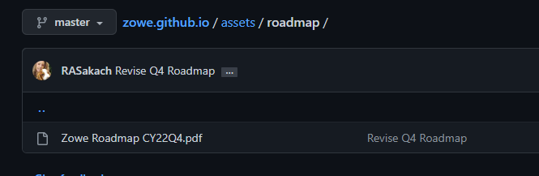
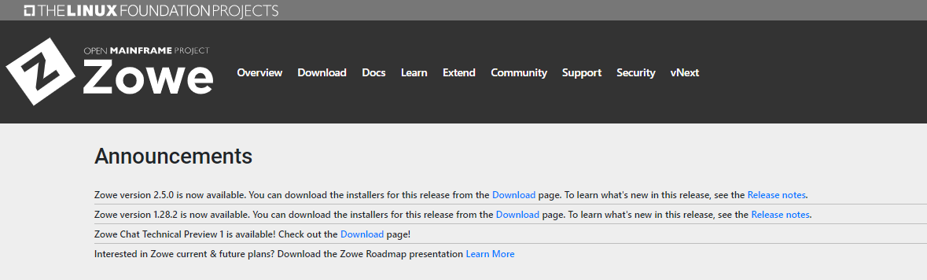
Our “Community Planning” Roadmap is POSTED
And download-able

Slide 7
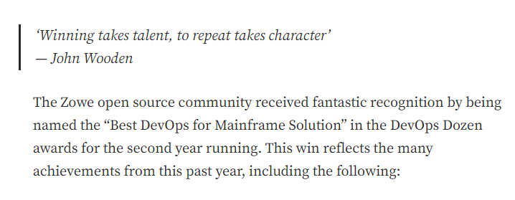
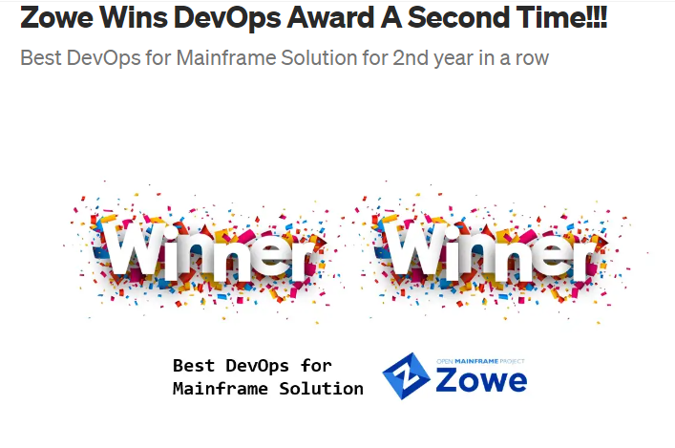
Zowe Wins… Again!
- Growth! Code, contributors, adoption
- V2 LTS Launch
- More Client SDKs
- New! Chat (incubator)
- New! Support Provider

Slide 8


Zowe Sessions at GSE UK “Overflow” Event
https://conferences.gse.org.uk/2023V/basic
Automate and Optimize Using Zowe Conformant REST APIs Elliot Jalley
IBM Db2 Administration Foundation – no charge replacement for administrative features in Data Studio and DSM Tom Crocker
Zowe and Zero Trust Architecture Jakub Balhar
Zowe Chat Domenico D'Alterio
Explore the Mainframe with Zowe Billie Jean Simmons
Are you using Data Studio, Data Server Manager, or Data Management Console and wondering what the strategic direction is for developers and administrators for Db2 for z/OS? S. Kameswaran
Wowee it’s Zowe! Hear how open source tooling is opening up IBM Z for new and for experienced mainframers alike Joe Winchester
AppDev workflow.......then & now Craig Hilburn
Notes:
There was so much demand for sessions and attendance at the in-person UK GSE, they added a February virtual event to handle the overflow

Slide 9

Zowe Sessions at SHARE Atlanta
https://www.share.org/Events/SHARE-Atlanta-2023/Technical-Agenda?
Can Zowe act as an enabler of innovations? Sure, it can! Jan Prihoda
Zowe: The First Five Years ZAC Panel
Zowe version 2 updates and beyond IBM ZAC’ers
Using the Right Tool for the Job - When to use z/OSMF, Ansible and, Zowe IBM Z/OSMF crew
Zowe extensions in IBM Z System Management (demo) Domenico d’Alterio
Good Bye to Baby-sitting your z/OS Jobs with Zowe Integrated JCL Checking (demo) Domenico d’Alterio
Customer Success Stories Using Zowe to Make Their Mainframe IT Operations More Efficient Joe Winchester
Tour Top Zowe Client Use Cases from medium.com/zowe! Dan Kelowsky
Diagnosing Transient Performance Issues by Analyzing SMF 98 and 100 Records in Zowe Dan Wiegand

Slide 10
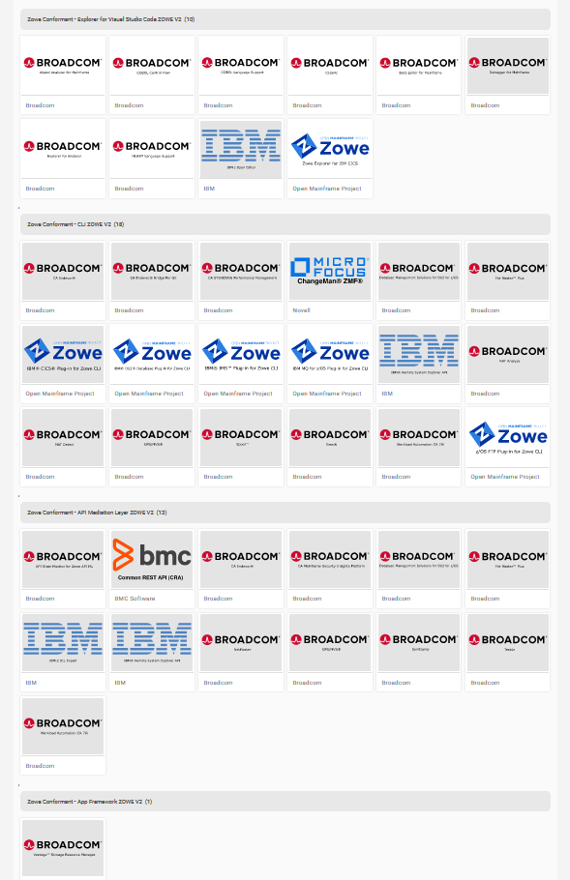
Zowe V2 Conformance
How are we doing?
Explorer (VS Code) - 10
CLI - 18
API ML – 14 (1 newly added)
App Framework - 1
43 V2 badges
Notes:
Expecting more badges in Q1 – (3 from IBM; 3 from Rocket)

Slide 11


Looking Forward - What’s on ZAC’s mind?
Strategic Planning
Make it easier for a googler to find roadmap
Bring more visibility and consumability to Zowe security narrative
Federated identity?
What to do with Zebra
Extender Diversity
Leverage Zowe Chat to expand Zowe participants
Tech, Tooling, & Hardware
Continue exploration with OMP/TSC in support of Training & Certification
Move off Zuul to Spring Gateway
Complete App Store
Notes:
Node 18 (hygiene)
Security hardening (Doc, presentation, ...)
Federated Identity
Chat
Move off Zuul to Spring Gateway
App Store
What to do with Zebra

Slide 12
Q&A
Notes:
Questions?

